Slide 1
Liaisons – OPC UA
Sebastian Käbisch
September 26, 2024
TPAC 2024

Slide 2


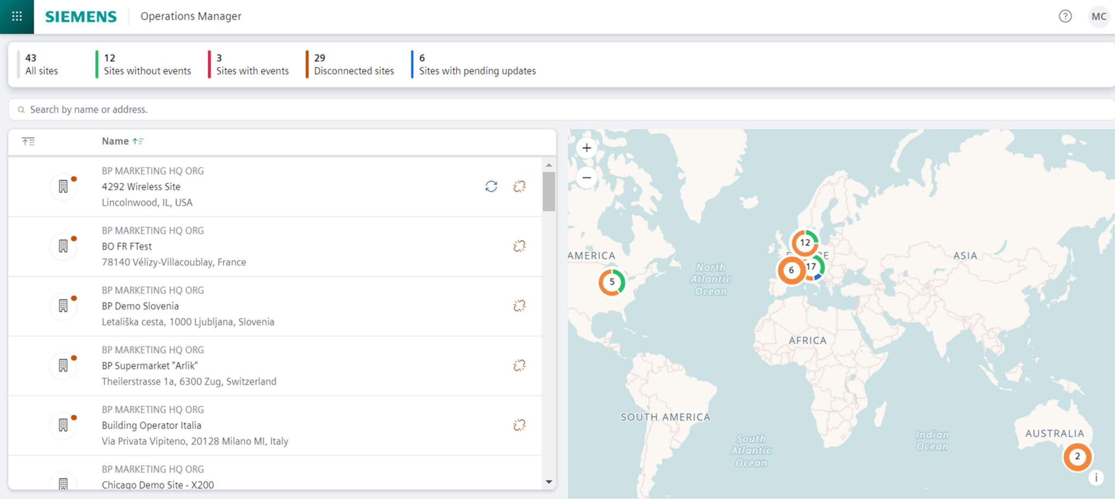
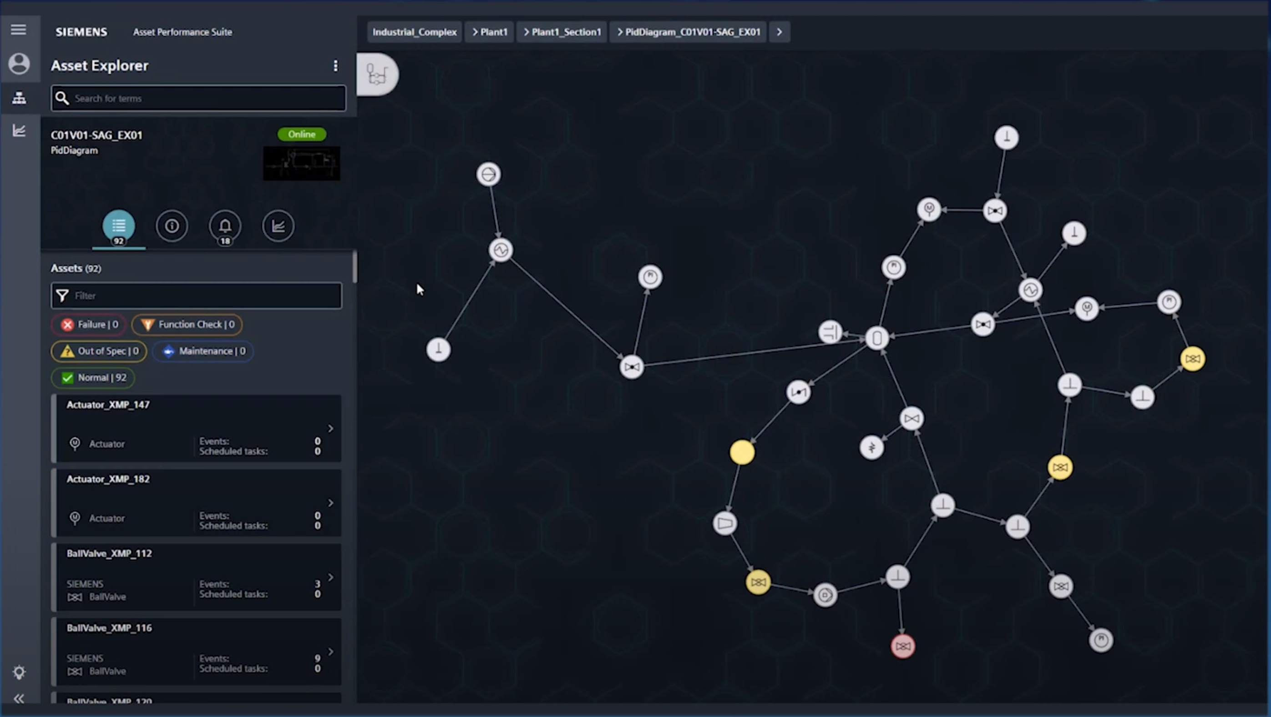
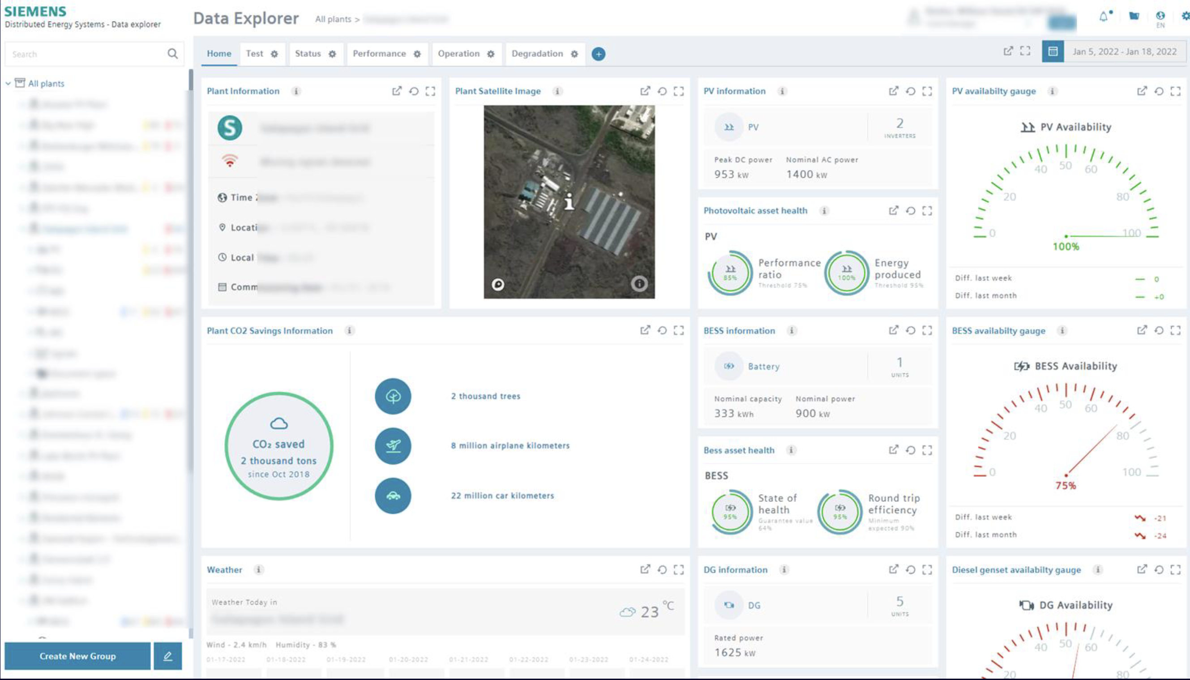
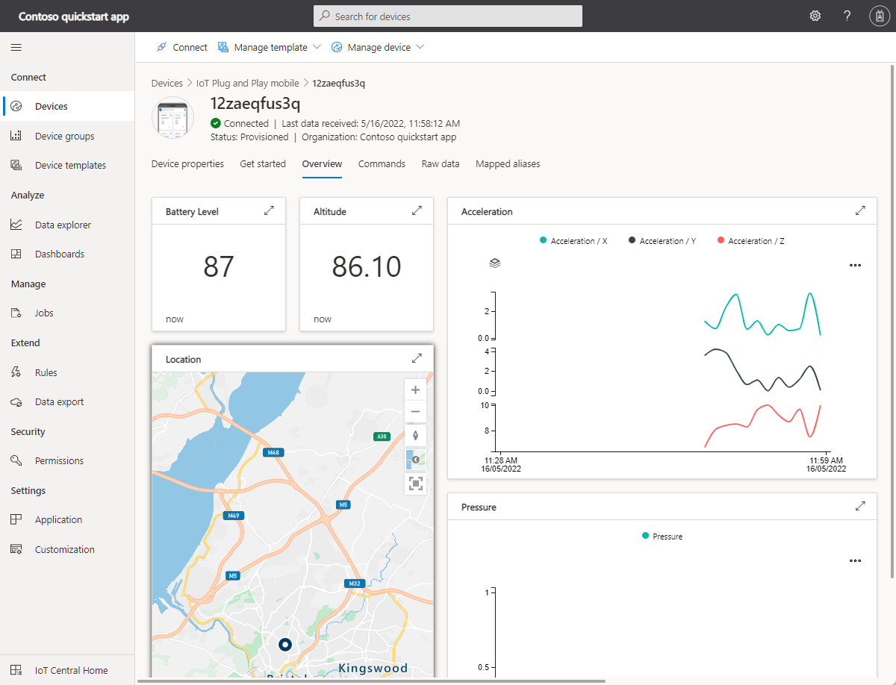
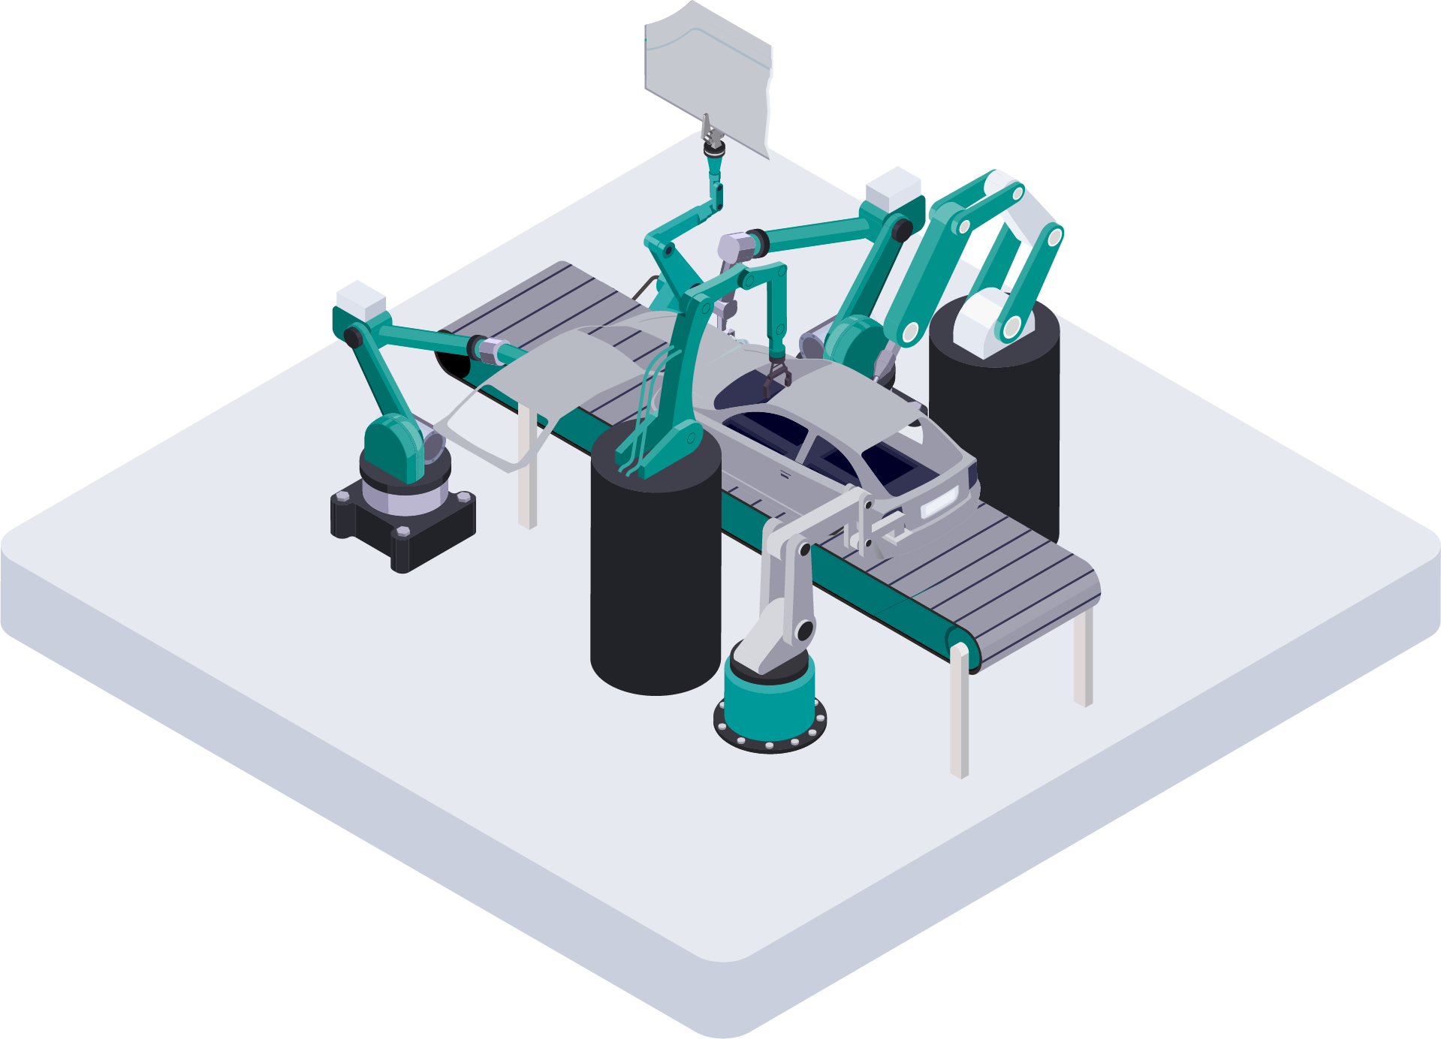
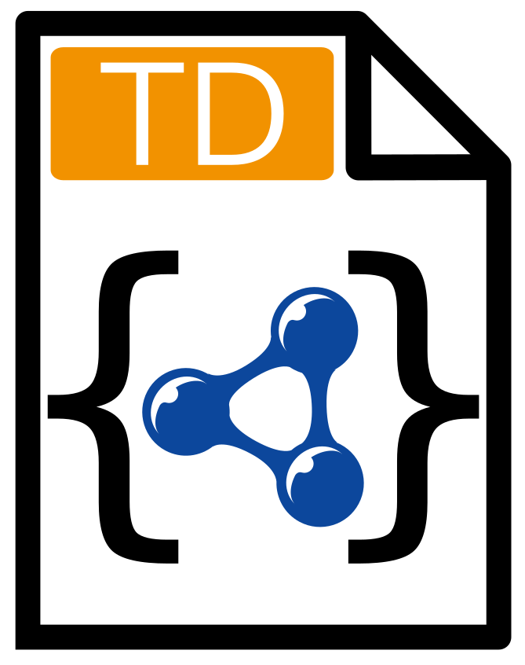

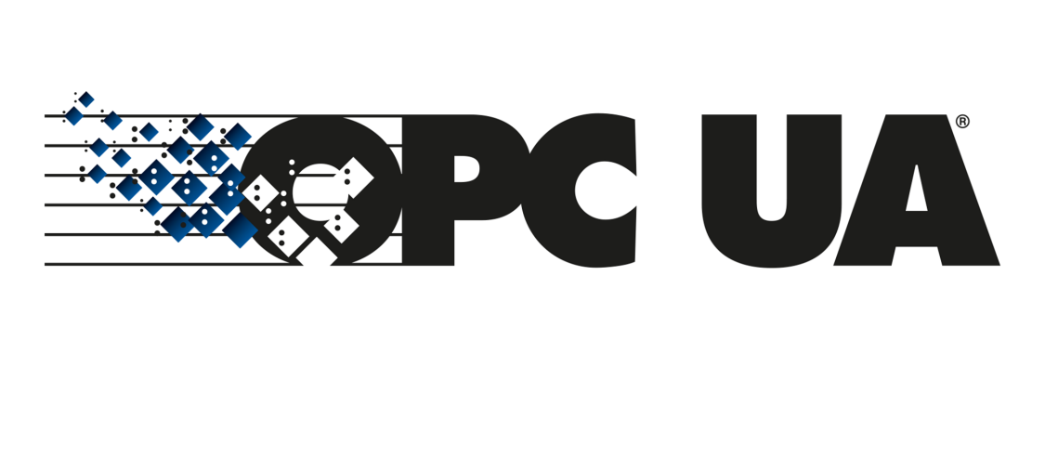
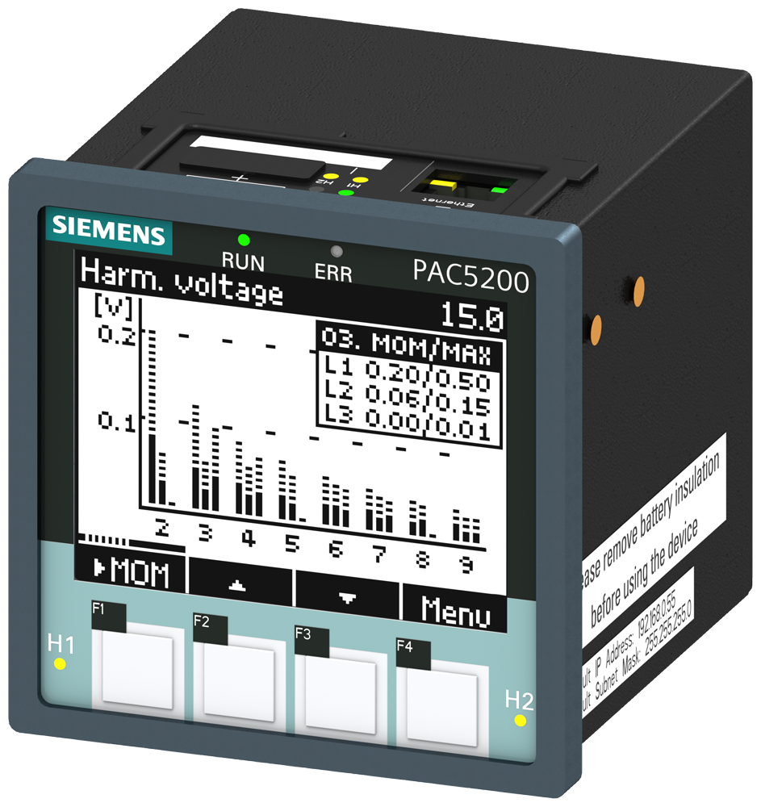
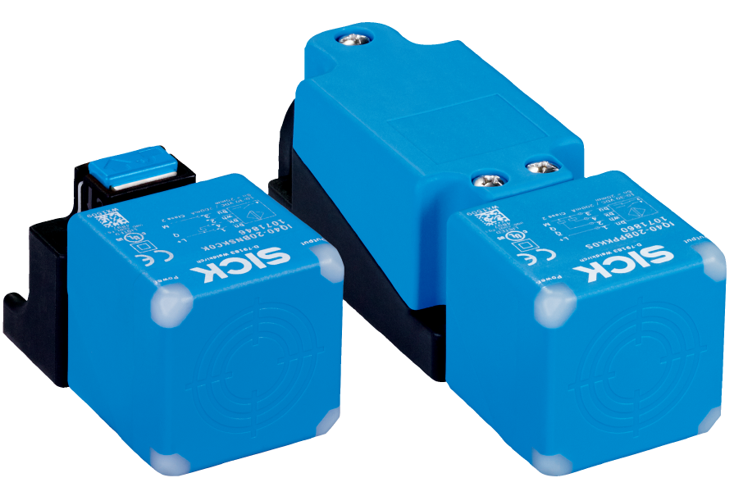
WoT as a complementary solution for OPC UA
Northbound
Provide TD to simplify orchestration with, e.g., non-OPC UA systems / devices (cross-domain scenarios) or rapid app development
OPC UA ecosystem (M2M, UA cloud, etc)
Just started
→ OPC UA Binding for WoT
Server / PubSub
Southbound
Use TDs to simplify onboarding of shop floor devices (Modbus, CAN, …) into OPC UA
…
Released
→ WoT Connectivity Companion

Slide 3
OPC UA Binding for WoT Status
WG started at OPC Foundation in July 2024
bi-weekly meetings
next on Tuesday October 8th, 7am PDT/4pm CEST
OPC UA Binding for WoT will be the first official external entry of the new binding registry concept of WoT 2.0
Awaiting the first draft for the PlugFest at the WoT week in Munich at the end of November (Details of WoT week here)

